Slide 1
Recursion
Chapter 11

Slide 2
Objectives
become familiar with the idea of recursion
learn to use recursion as a programming tool
become familiar with the binary search algorithm as an example of recursion
become familiar with the merge sort algorithm as an example of recursion

Slide 3
Outline
The Basics of Recursion
Programming with Recursion

Slide 4
The Basics of Recursion: Outline
Introduction to Recursion
How Recursion Works
Recursion versus Iteration
Recursive Methods That Return a Value

Slide 5
Introduction to Recursion
Sometimes it is possible and useful to define a method in terms of itself.
A Java method definition is recursive if it contains an invocation of itself.
The method continues to call itself, with ever simpler cases, until a base case is reached which can be resolved without any subsequent recursive calls.

Slide 6
Example: Search for a Name in a Phone Book
Open the phone book to the middle.
If the name is on this page, you’re done.
If the name alphabetically precedes the names on this page, use the same approach to search for the name in the first half of the phone book.
Otherwise, use the same approach to search for the name in the second half of the phone book.

Slide 7
Case Study: Digits to Words
Write a definition that accepts a single integer and produces words representing its digits.
example
  input: 223
  output: two two three
recursive algorithm
  output all but the last digit as words
  output the word for the last digit

Slide 8
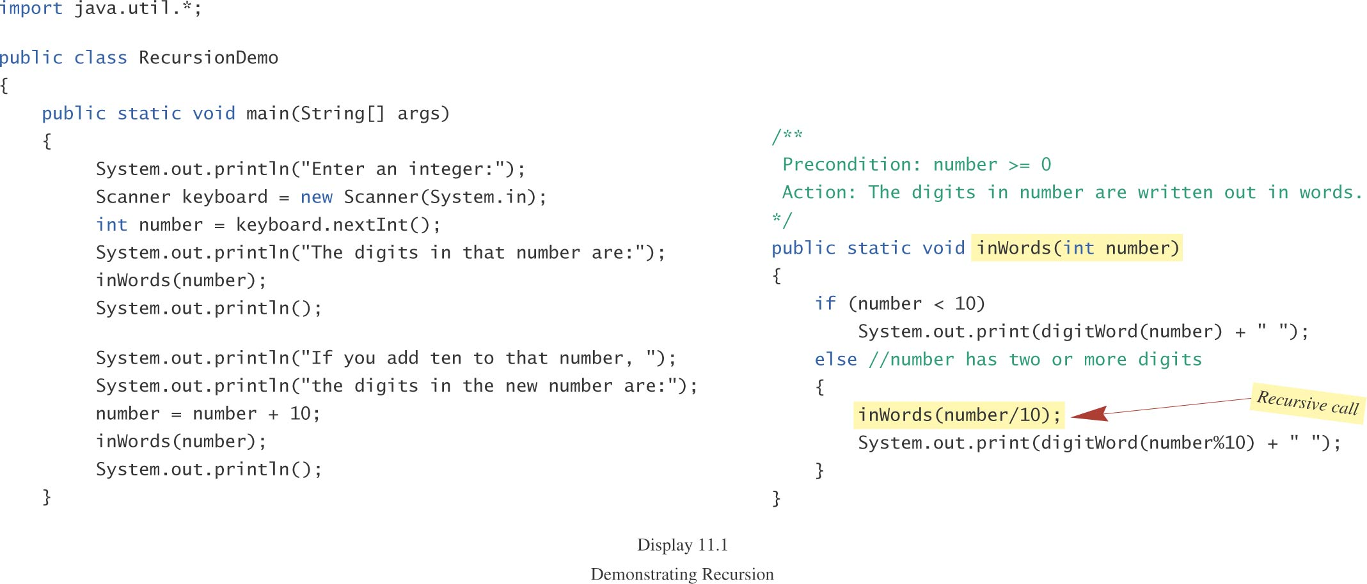
Case Study: Digits to Words, cont.

Slide 9
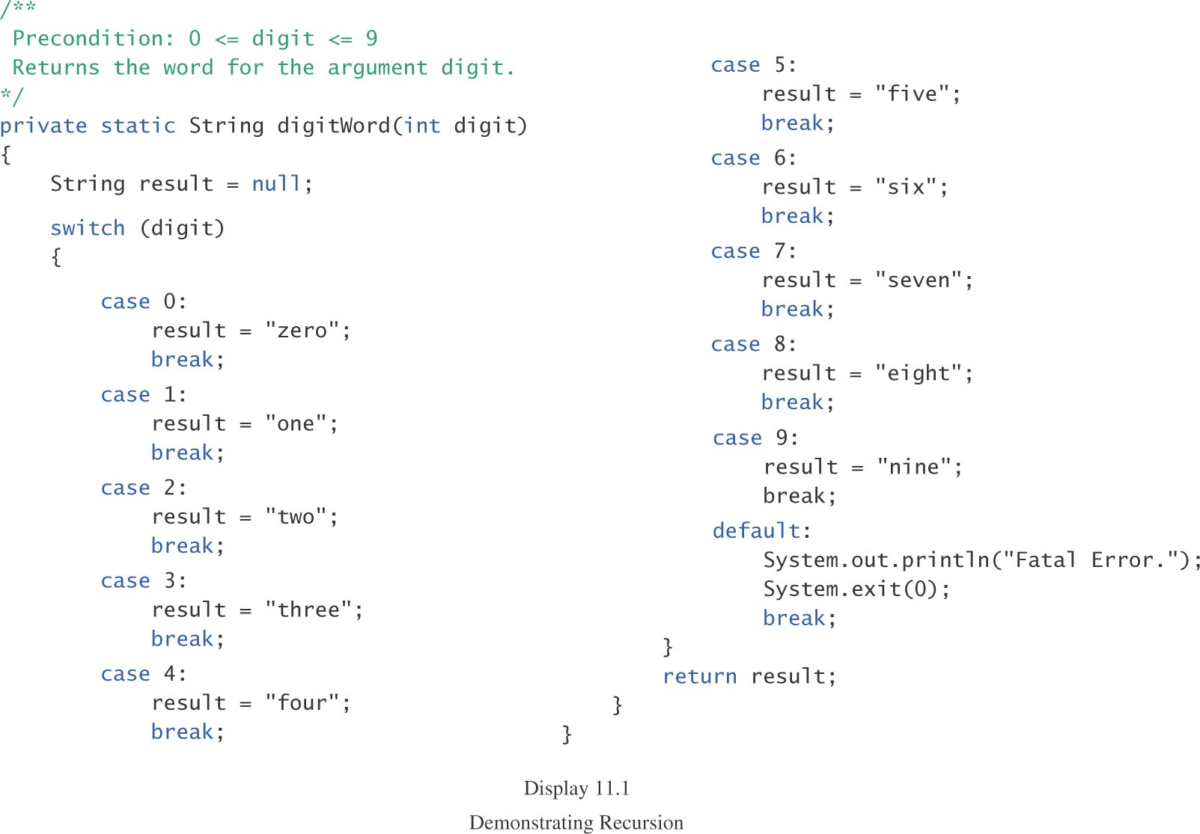
Case Study: Digits to Words, cont.

Slide 10
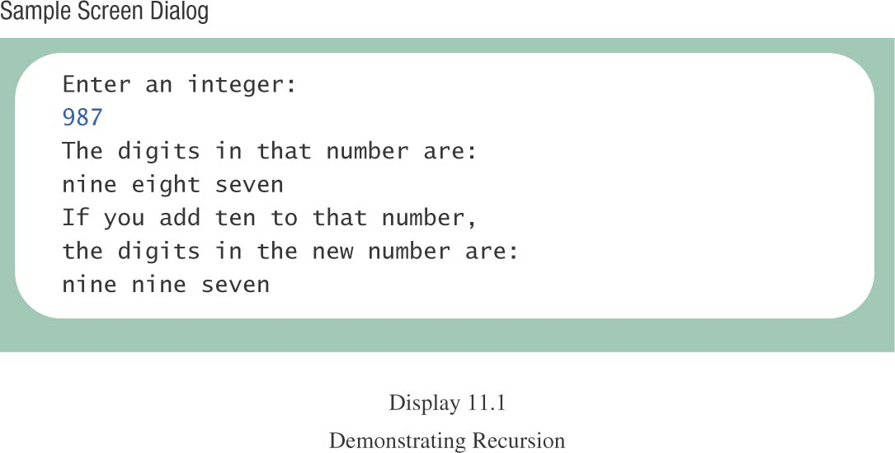
Case Study: Digits to Words, cont.

Slide 11
How Recursion Works
Nothing special is required to handle a call to a recursive method, whether the call to the method is from outside the method or from within the method.
At each call, the needed arguments are provided, and the code is executed.
When the method completes, control returns to the instruction following the call to the method.

Slide 12
How Recursion Works, cont.
Consider several methods m1, m2, …, mn, with method m1 calling method m2, method m2 calling method m3,…, calling method mn.
  When each method completes, control returns to the instruction following the call to the method.
In recursion, methods m1, m2, …, mn are all the same method, but each call results in a distinct execution of the method.

Slide 13
How Recursion Works, cont.
As always, method m1 cannot complete execution until method m2 completes execution, method m2 cannot complete execution until method m3 completes execution, …, until method mn completes execution.
If method mn represents a stopping case, it can complete execution, …, then method m2 can complete execution, then method m1 can complete execution.

Slide 14
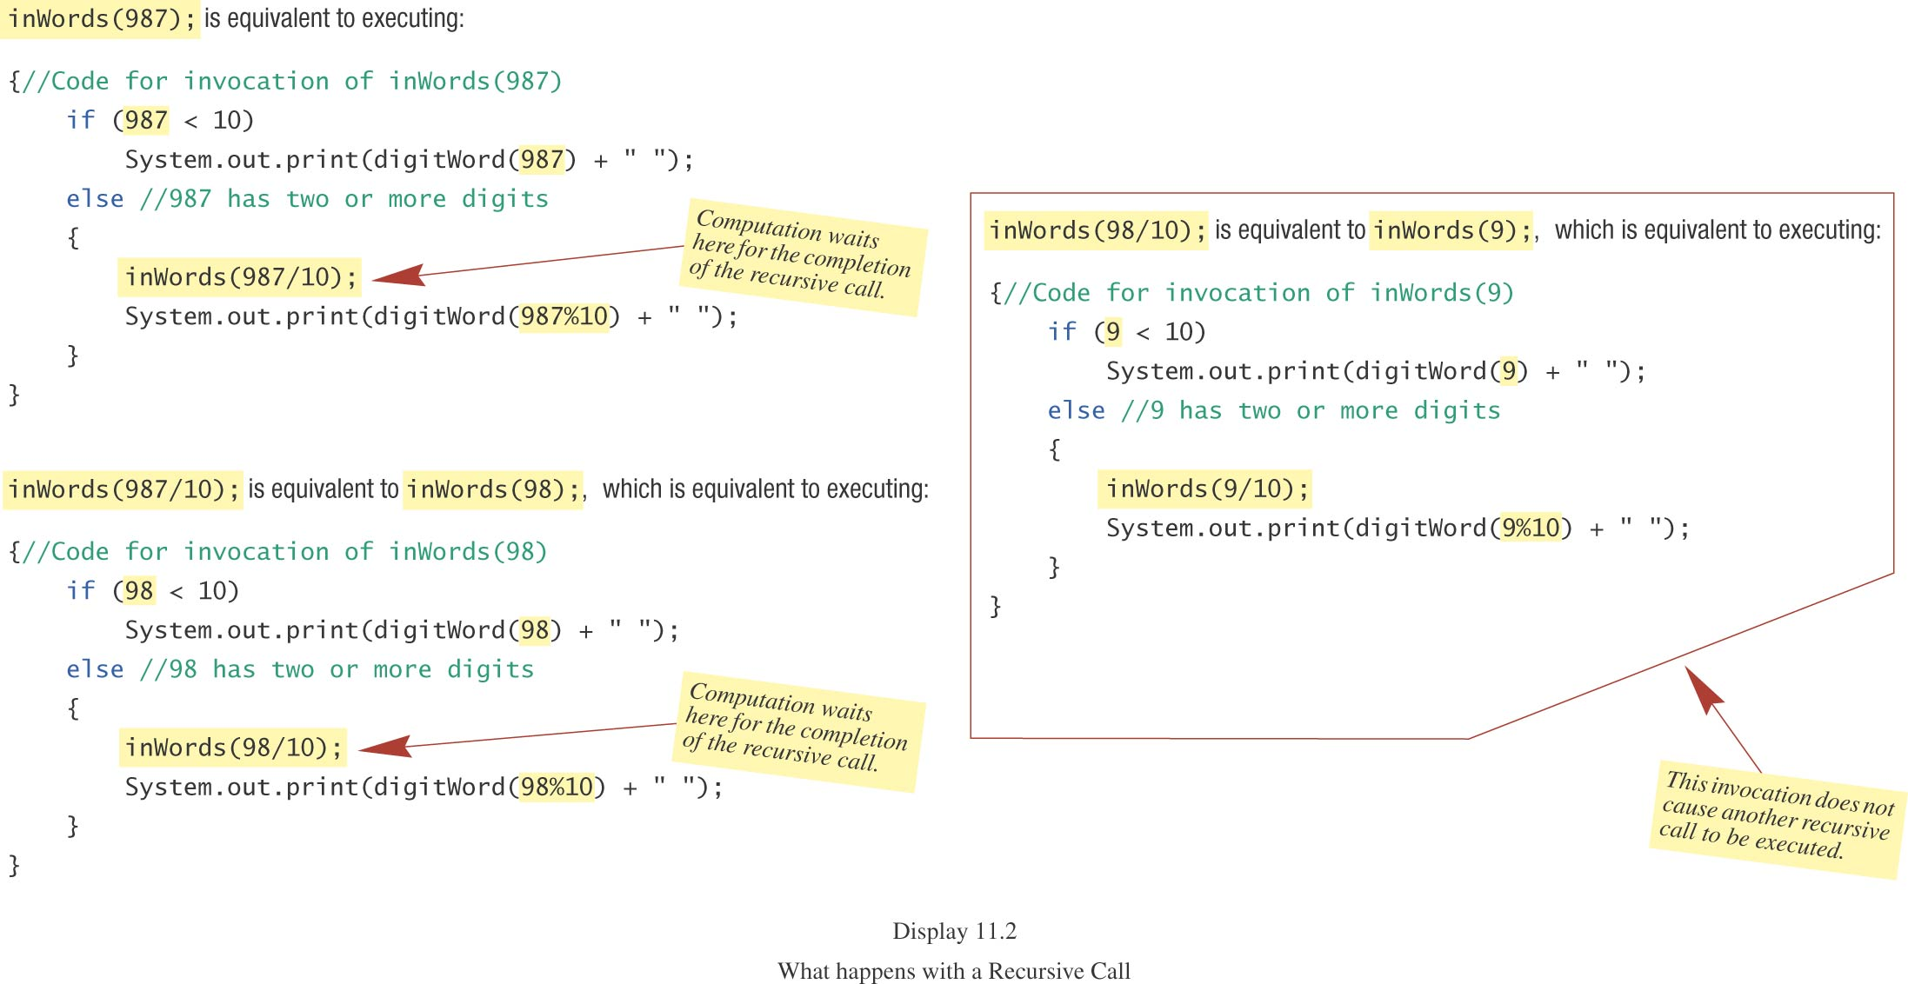
How Recursion Works, cont.

Slide 15
Recursion Guidelines
The definition of a recursive method typically includes an if-else statement.
  One branch represents a base case which can be solved directly (without recursion).
  Another branch includes a recursive call to the method, but with a “simpler” or “smaller” set of arguments.
Ultimately, a base case must be reached.

Slide 16
Infinite Recursion
If the recursive invocation inside the method does not use a “simpler” or “smaller” parameter, a base case may never be reached.
Such a method continues to call itself forever (or at least until the resources of the computer are exhausted as a consequence of stack overflow).
This is called infinite recursion.

Slide 17
Infinite Recursion, cont.
example (with the stopping case omitted)
  inWords(987);
  ...
  public static void inWords(int number)
  {
  inWords(number/10);
  System.out.print(digitWord(number%10)
  + “ “);
  }

Slide 18
Recursion vs. Iteration
Any recursive method can be rewritten without using recursion.
Typically, a loop is used in place of the recursion.
The resulting method is referred to as the iterative version.

Slide 19
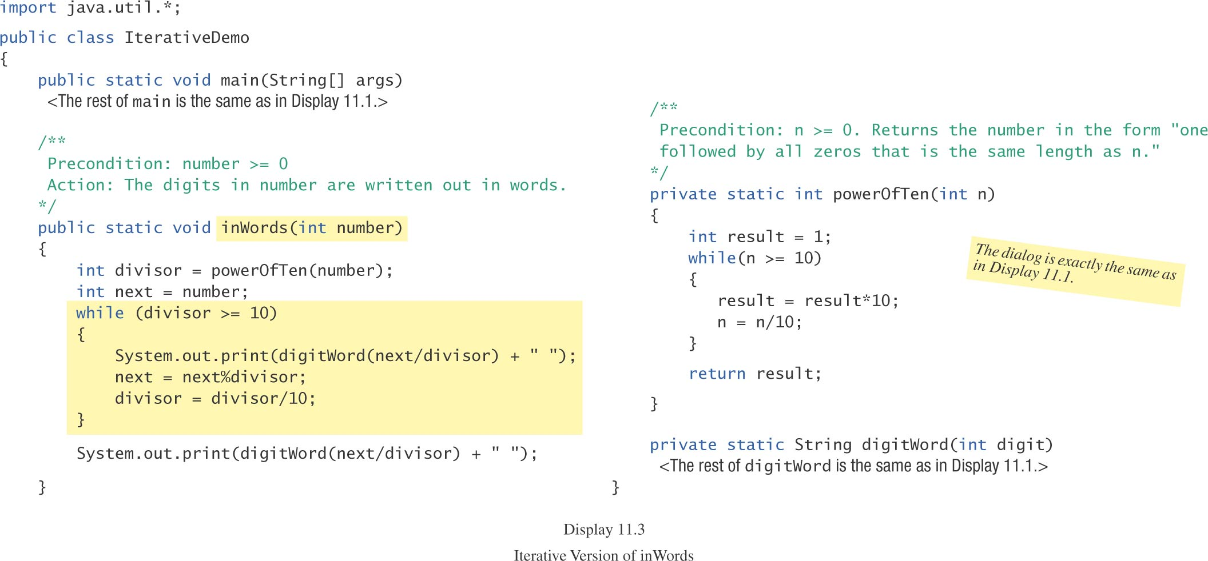
Recursion vs. Iteration, contd.

Slide 20
Recursion vs. Iteration, cont.
A recursive version of a method typically executes less efficiently than the corresponding iterative version.
This is because the computer must keep track of the recursive calls and the suspended computations.
However, it can be much easier to write a recursive method than it is to write a corresponding iterative method.

Slide 21
Recursive Methods That Return a Value
A recursive method can be a void method or it can return a value.
At least one branch inside the recursive method can compute and return a value by making a chain of recursive calls.
Consider, for example, a method that takes a single int argument and returns the number of zeros in the argument.

Slide 22
Recursive Methods That Return a Value, cont.
If n is two or more digits long, then the number of zero digits in n is (the number of zeros in n with the last digit removed) plus an additional one of the last digit is a zero.

Slide 23
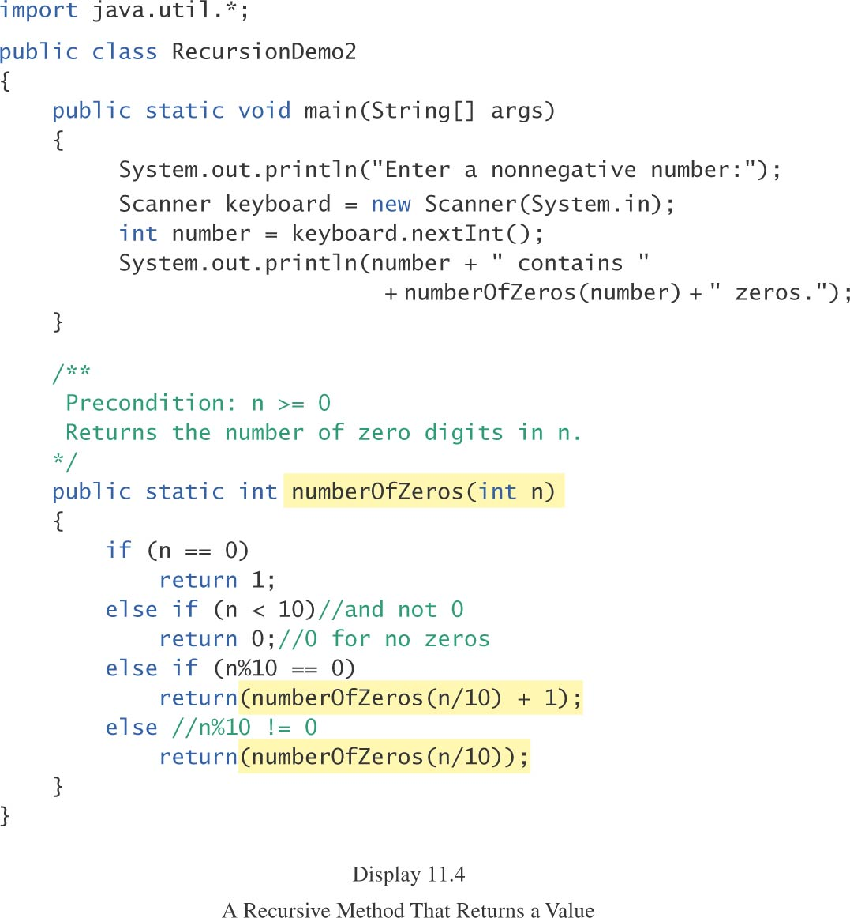
Recursive Methods That Return a Value, cont.

Slide 24
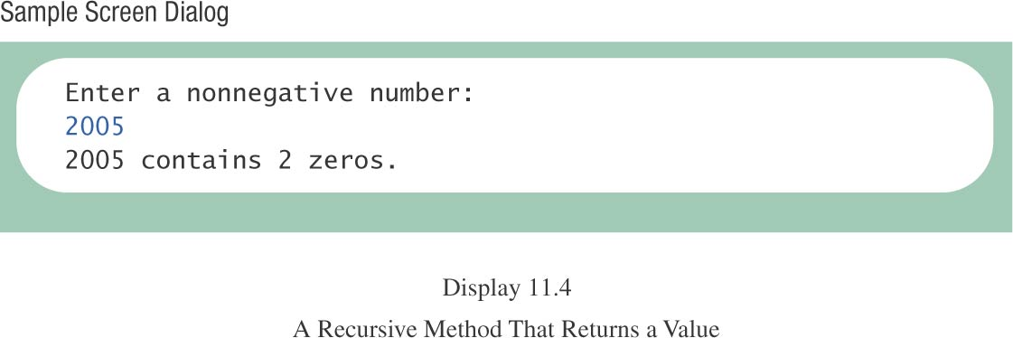
Recursive Methods That Return a Value, cont.

Slide 25
Recursive Methods That Return a Value, cont.
What is the value of each of the following expressions?
  numberOfZeros(20030)
  numberOfZeros(20031)
  numberOfZeros(0)
  numberOfZeros(5)
  numberOfZeros(50)

Slide 26
Overloading is Not Recursion
If a method name is overloaded and one method calls another method with the same name but with a different parameter list, this is not recursion.
Of course, if a method name is overloaded and the method calls itself, this is recursion.
Overloading and recursion are neither synonymous nor mutually exclusive.

Slide 27
Programming with Recursion: Outline
Counting Down
Binary Search
Merge Sort

Slide 28
Counting Down
In this example, method getCount requests a positive number and then counts down to zero.
If a nonpositive number is entered, method getCount calls itself recursively.

Slide 29
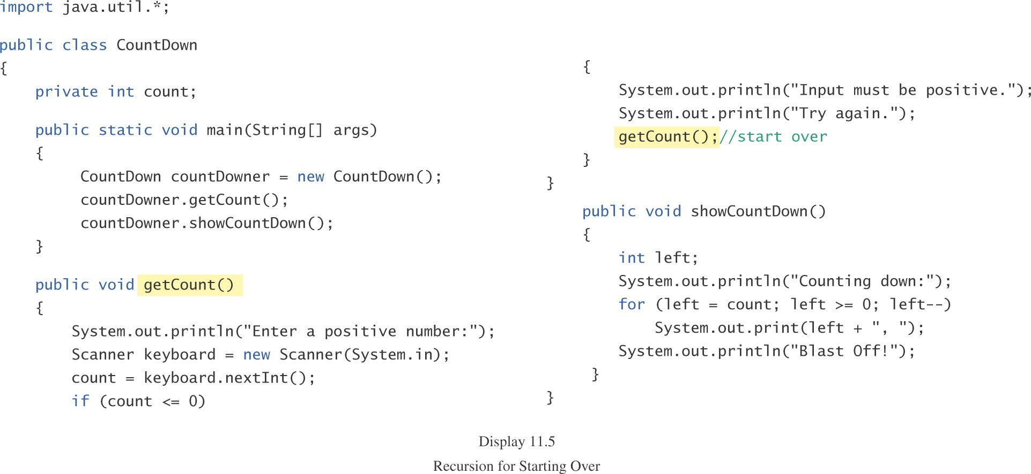
Counting Down, cont.

Slide 30
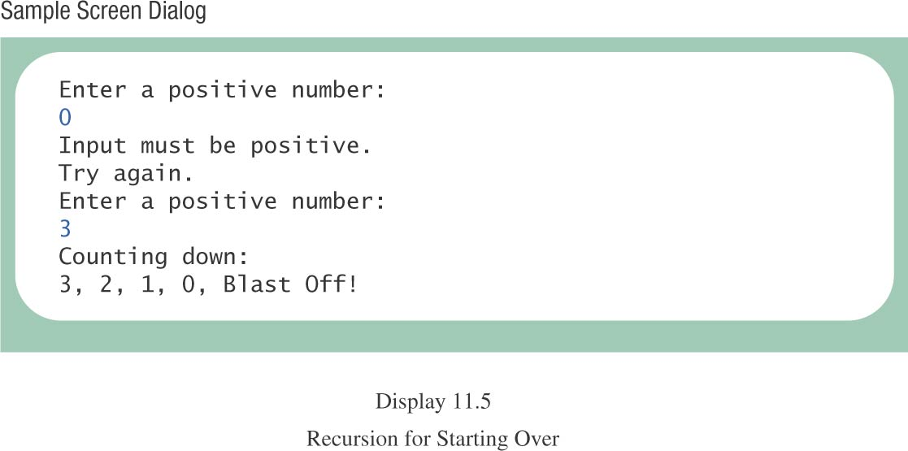
Counting Down, cont.

Slide 31
Case Study: Binary Search
We will design a recursive method that determines if a given number is or is not in a sorted array.
  If the number is in the array, the method will return the position of the given number in the array, or -1 if the given number is not in the array.
Instead of searching the array linearly, we will search recursively for the given number.

Slide 32
Binary Search, cont.
Because the array is sorted, we can rule out whole sections of the array as we search.
  For example, if we are looking for a 7 and we encounter a location containing a 9, we can eliminate from consideration the location containing the 9 and all subsequent locations in the array.

Slide 33
Binary Search, cont.
  Similarly, if we are looking for a 7 and we encounter a location containing a 3, we can eliminate from consideration the location containing the 3 and all preceding locations in the array.
  And of course, if we are looking for a 7 and we encounter a location containing a 7, we can terminate our search, just as we could when searching an array linearly.

Slide 34
Binary Search, cont.
We can begin our search by examining an element mid in the middle of the array.
pseudocode, first draft:
  mid = (0 + a.length-1)/2
  if (target == a[mid])
  return mid;
  else if (target < a[mid]
  search a[0] through a[mid-1]
  else search a[mid + 1] through
  a[a.length - 1]

Slide 35
Binary Search, cont.
pseudocode, generalized for recursive calls:
  mid = (first + last)/2
  if (target == a[mid])
  return mid;
  else if (target < a[mid]
  search a[first] through a[mid-1]
  else search a[mid + 1] through
  a[last]

Slide 36
Binary Search, cont.
But what if the number is not in the array?
  first eventually becomes larger than last and we can terminate the search.
Our pseudocode needs to be amended to test if first has become larger than last.

Slide 37
Binary Search, cont.
  mid = (first + last)/2
  if (first > last)
  return -1;
  else if (target == a[mid])
  return mid;
  else if (target < a[mid]
  search a[first] through a[mid-1]
  else search a[mid + 1] through
  a[last]

Slide 38
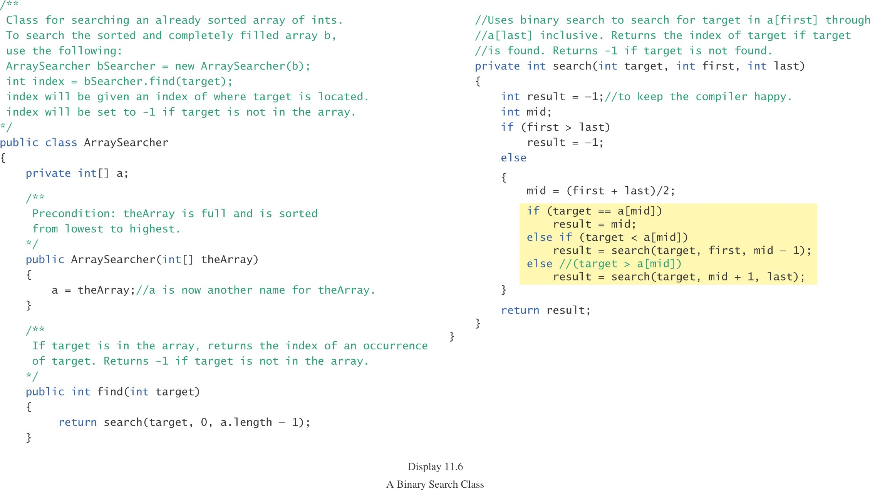
Binary Search, cont.

Slide 39
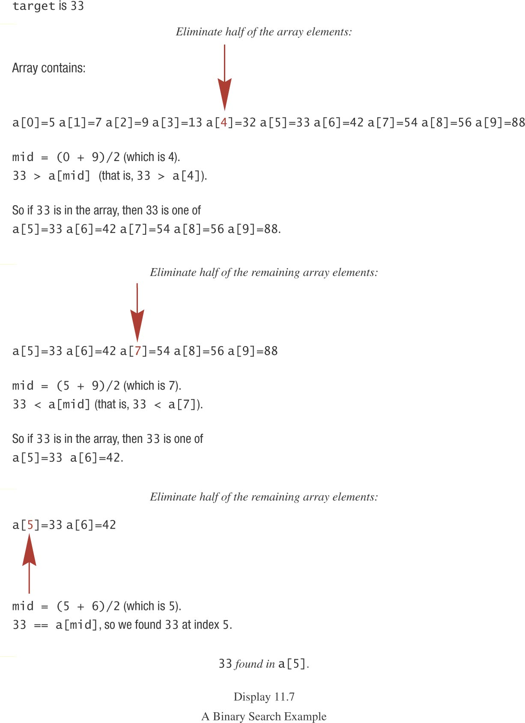

Slide 40
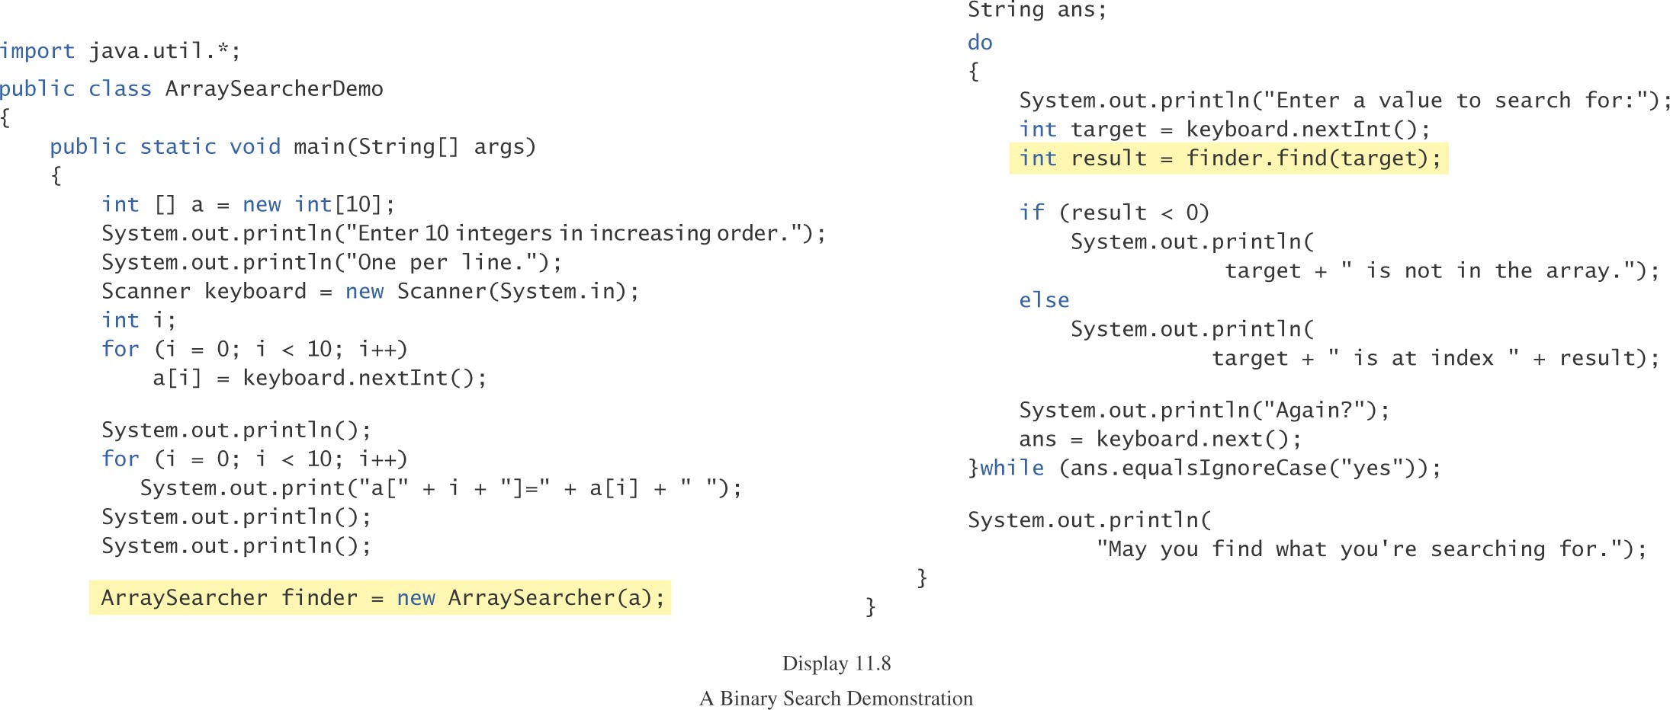

Slide 41
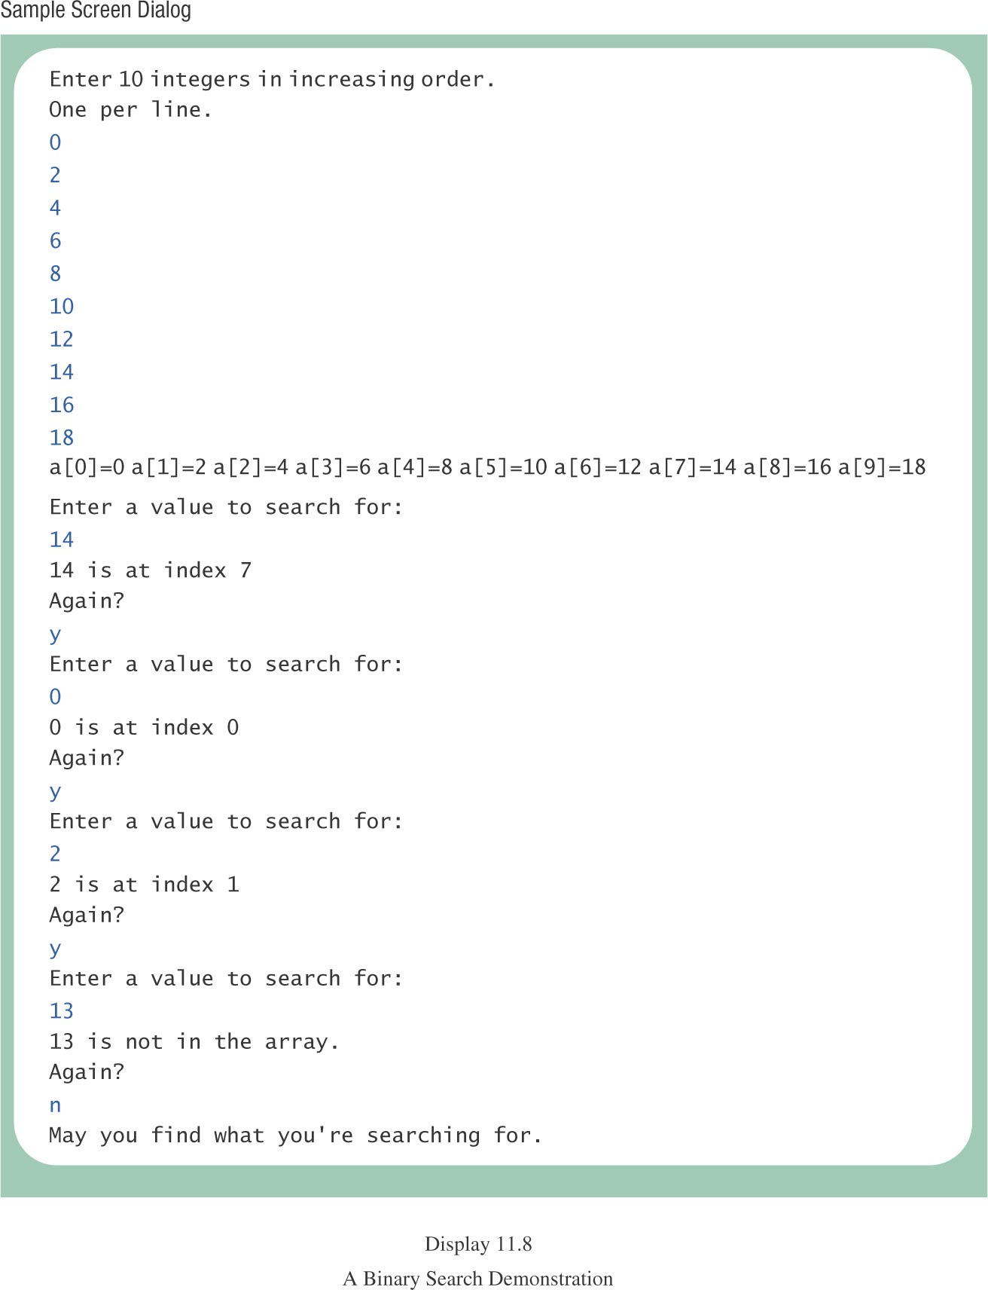

Slide 42
Binary Search, cont.
With each recursion, the binary search eliminates about half of the array under consideration from further consideration.
The number of recursions required either to find an element or to determine that the item is not present is log n for an array of n elements.
Thus, for an array of 1000 elements, only 10 recursions are needed.

Slide 43
Merge Sort
Efficient sorting algorithms often are stated recursively.
One such sort, merge sort, can be used to sort an array of items.
Merge sort takes a “divide and conquer” approach.
  The array is divided in halves and the halves are sorted recursively.
  Sorted subarrays are merged to form a larger sorted array.

Slide 44
Merge Sort, cont.
pseudocode
  If the array has only one element,
  stop.
  Otherwise
  Copy the first half of the elements
  into an array named front.
  Copy the second half of the elements
  into an array named back.
  Sort array front recursively.
  Sort array tail recursively.
  Merge arrays front and tail.

Slide 45
Merging Sorted Arrays
The smallest element in array front is front[0].
The smallest element in array tail is tail[0].
The smallest element will be either front[0] or tail[0].
Once that element is removed from either array front or array tail, the smallest remaining element once again will be at the beginning or array front or array tail.

Slide 46
Merging Sorted Arrays, cont.
Generalizing, two sorted arrays can be merged by selectively removing the smaller of the elements from the beginning of (the remainders) of the two arrays and placing it in the next available position in a larger “collector” array.
When one of the two arrays becomes empty, the remainder of the other array is copied into the “collector” array.

Slide 47
Merging Sorted Arrays, cont.
int frontIndex = 0, tailIndex = 0, aIndex = 0;
while (frontIndex , front.length) &&
(tailIndex < tail.length))
{
if(front[frontIndex] < tail[tailIndex]}
{
a[aIndex] = front[frontIndex];
aIndex++;
frontIndex++;
}

Slide 48
Merging Sorted Arrays, cont.
else
{
a[aIndex] = tail[tailIndex];
aIndex++;
tailIndex++
}
}

Slide 49
Merging Sorted Arrays, cont.
Typically, when either array front or array tail becomes empty, the other array will have remaining elements which need to be copied into array a.
Fortunately, these elements are sorted and are larger than any elements already in array a.

Slide 50
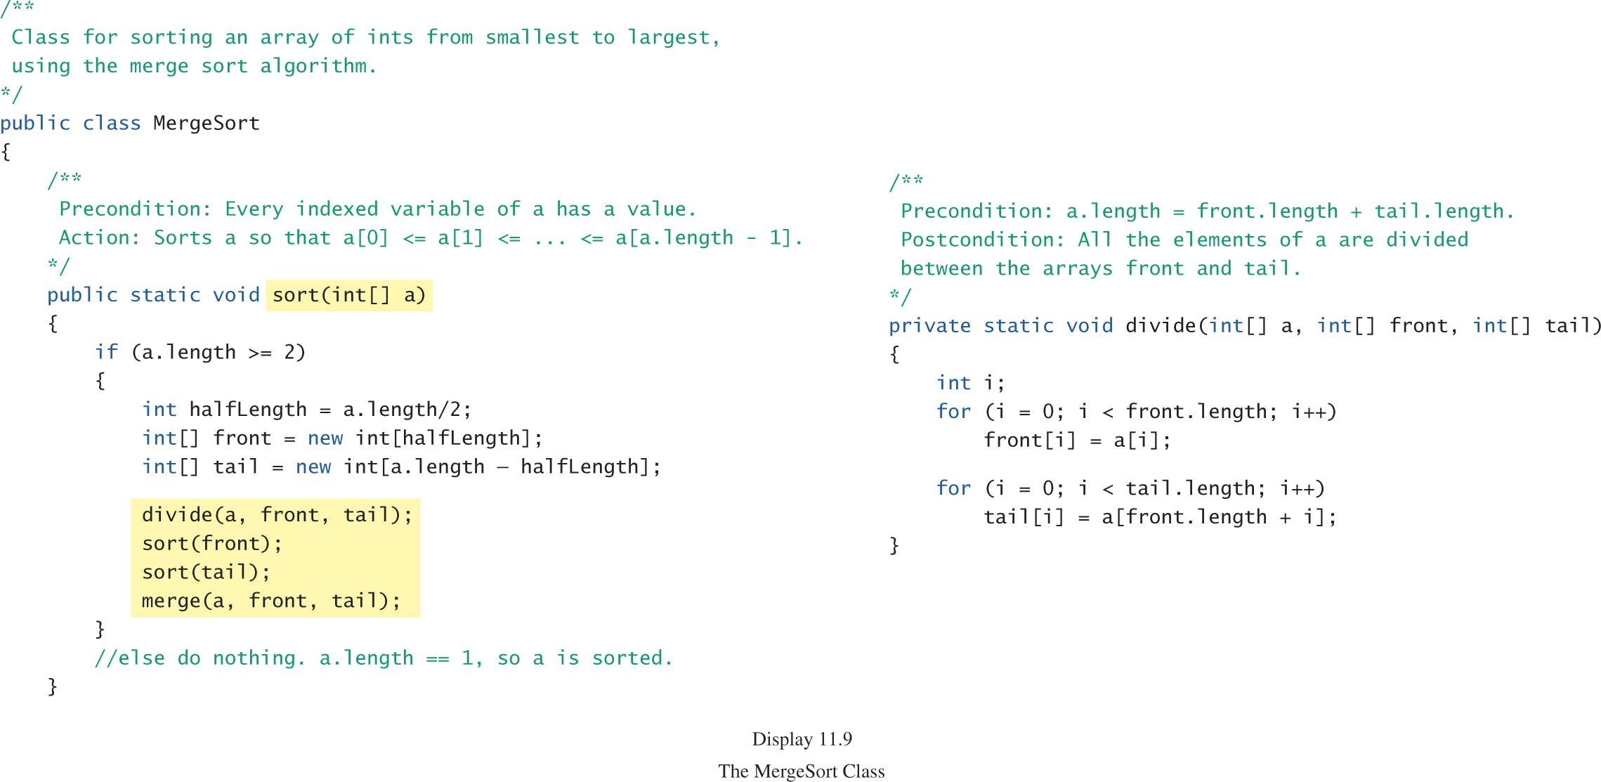
Merge Sort, cont.

Slide 51
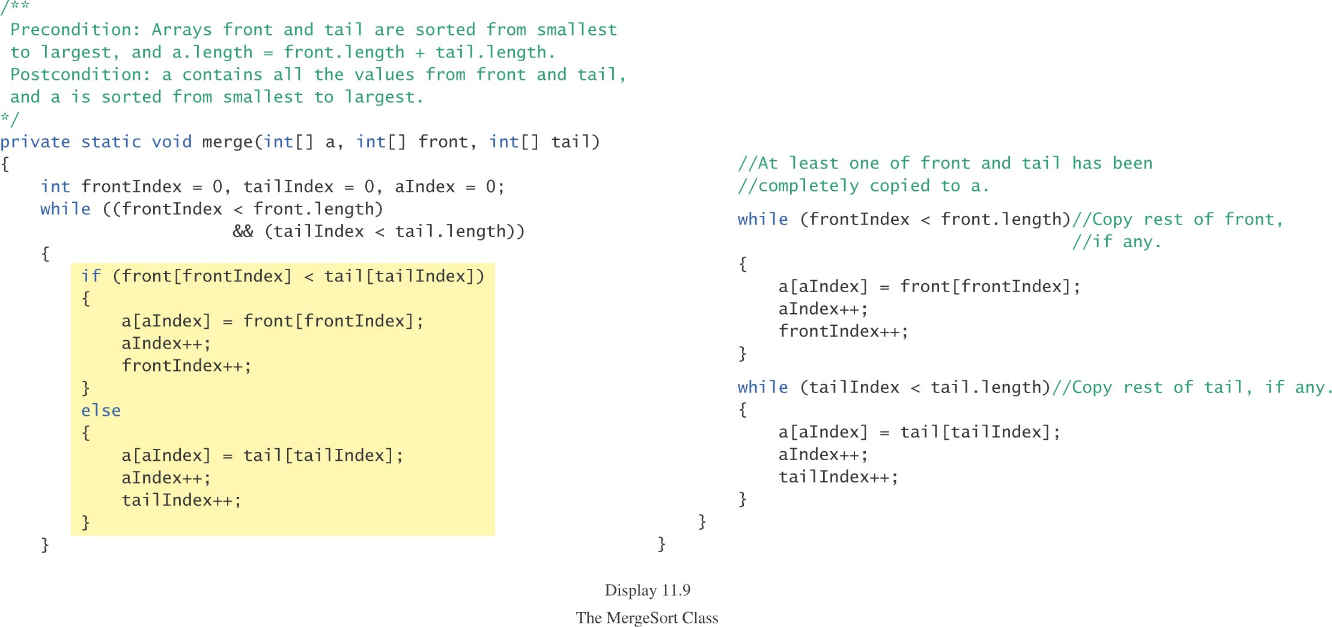

Slide 52
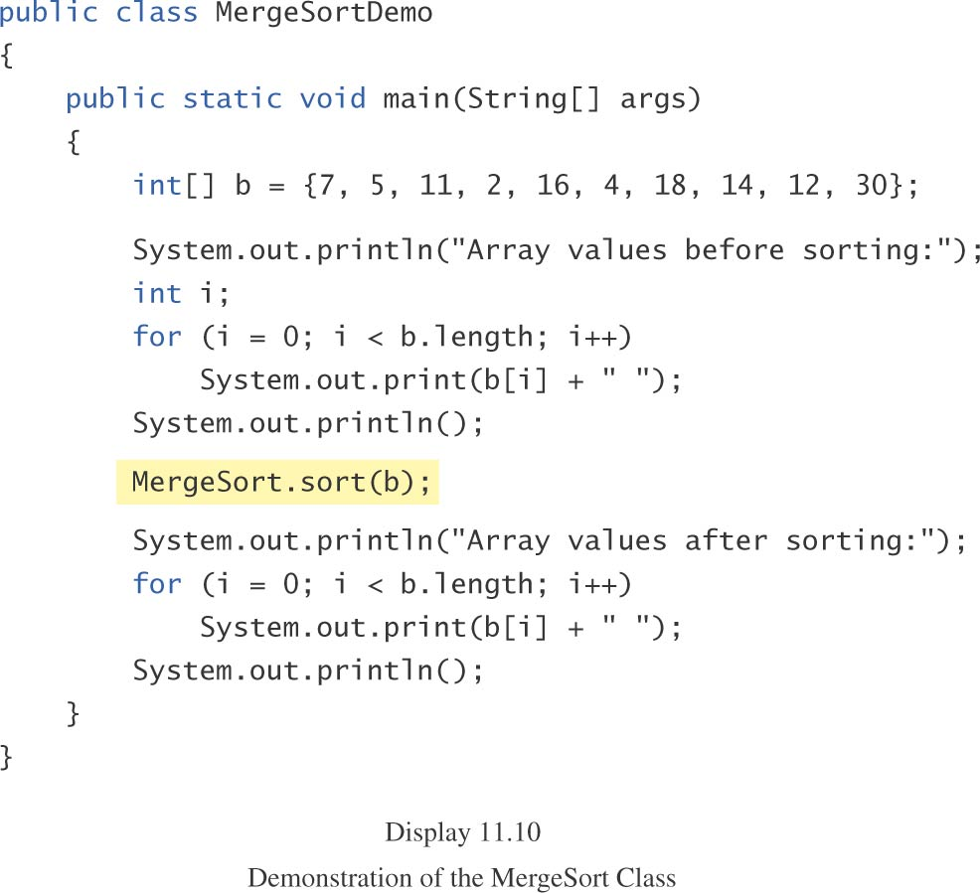
Merge Sort, cont.

Slide 53
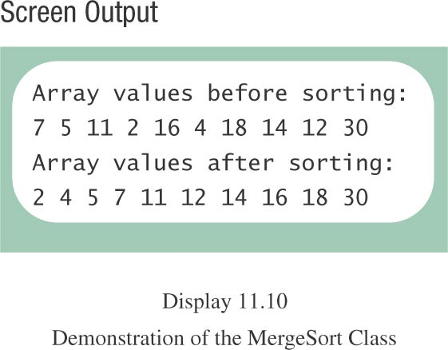
Merge Sort, cont.

Slide 54
Merge Sort, cont.
The merge sort algorithm is much more efficient than the selection sort algorithm considered previously.

Slide 55
Summary
You have become familiar with the idea of recursion.
You have learned to use recursion as a programming tool.
You have become familiar with the binary search algorithm as an example of recursion.
You have become familiar with the merge sort algorithm as an example of recursion.

